Slide 1
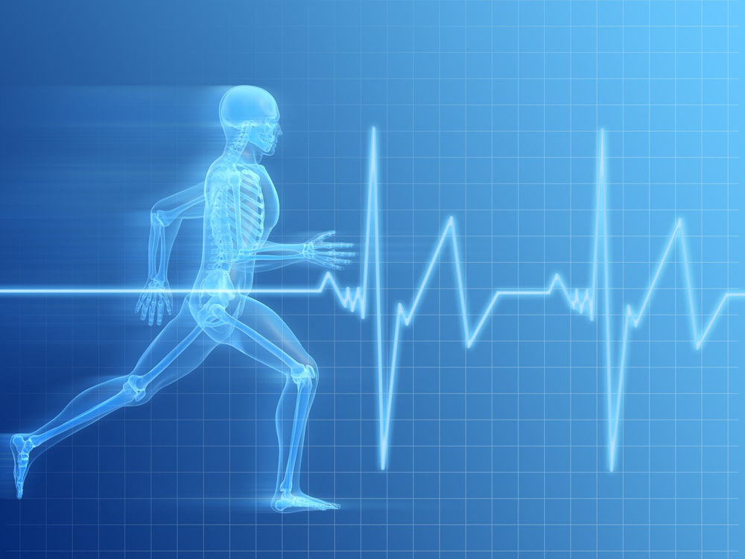
Cardiovascular Fitness

Slide 2
What is Cardiovascular Fitness
It is the ability of the heart and lungs to supply oxygen-rich blood to the working muscle tissues and the ability of the muscle to use oxygen to produce energy for the movement.
Resting HR- Rate at which your heart beats at rest (while sitting or being inactive). Low resting heart rates are a good measure of health and fitness
A persons ability to deliver oxygen to the muscle is affected by many physiological components including each of the following:

Slide 3
Physiological Components
Heart Rate- the rate at which the heart beats
Stroke Volume- the volume of blood pumped out of the ventricle of the heart in a single beat
Cardiac Output- the amount of blood pumped out by the ventricles in a given period of time
Maximal Oxygen Consumption- the rate of oxygen uptake at the highest work rate.

Slide 4
Add song here

Slide 5
Metabolic Training
The short definition of metabolic training is exercises with little rest in between exercises in an effort to maximize calorie burn and increase metabolic rate during and after the workout.
FYI, your metabolism (aka metabolic rate) is how many calories your body burns at rest.

Slide 6
2 Types of Metabolic Training
Aerobic exercise- Any rhythmic activity that increases the body's need for oxygen by using large muscle groups continuously for at least 10 minutes. The term aerobic means “with oxygen.”
Anaerobic exercise- Short lasting, high intensity activity, where the demand for oxygen from the exercise exceeds the oxygen supply

Slide 7


Examples of Aerobic and Anaerobic EXERCISE
Aerobic exercise would include:
    Swimming
    Jogging
    Taking a walk
    Biking
    Slow Burn

Slide 8

Examples of Aerobic and Anaerobic EXERCISE
Anaerobic exercise would include:
    Swimming
    Running or sprinting
    Sprinting on your bike
    Burn fat for energy
    Fast burn

Slide 9
Body Mass Index (BMI)
Body Mass Index (BMI)- Measure of the relationship between height and weight; calculated by dividing weight in kilograms
Pounds and inches | Formula: weight (lb) / [height (in)]² x 703Calculate BMI by dividing weight in pounds (lbs) by height in inches (in) squared and multiplying by a conversion factor of 703. Example: Weight = 150 lbs, Height = 5'5" (65") Calculation: [150 ÷ (65)²] x 703 = 24.96

Slide 10
BMI
BMI does not measure body fat directly, but research has shown that BMI correlates to direct measures of body fat, such as underwater weighing and dual energy x-ray absorptiometry (DXA).^{1, 2}
BMI can be considered an alternative for direct measures of body fat.

Slide 11
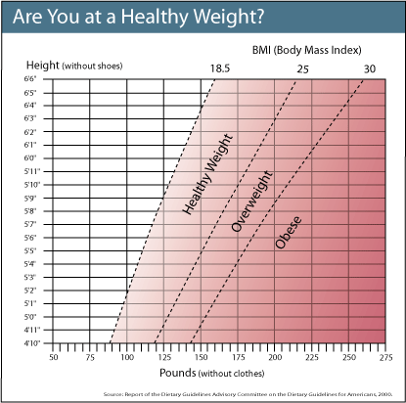
BMI Chart

Slide 12
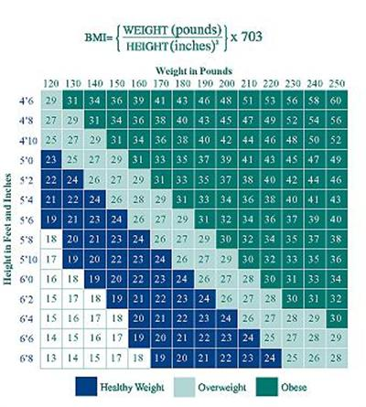
BMI Chart

Slide 13
Body Composition
Body composition- Amount of fat vs. lean muscle tissue in the human body.
Lean mass- Total weight of your muscle, bone, and all other body organs. (Everything in the body besides fat.)
This is where you find your percent body fat.

Slide 14
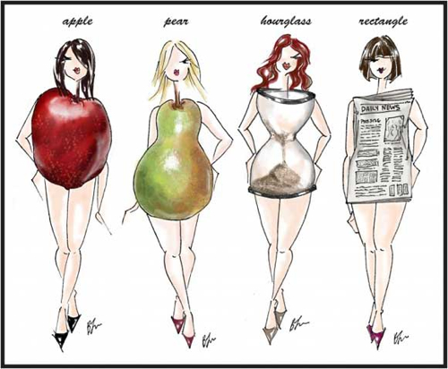
Body Shapes and Your Heart

Slide 15
Body Shapes and Your Heart
Take a few minutes and research body shapes and your heart.
  Which is good and which is bad for your health? And why?
  How does each body shape impact your heart health?
  Which are you?
  What is the best style of jeans/pants for you to wear?

Slide 16
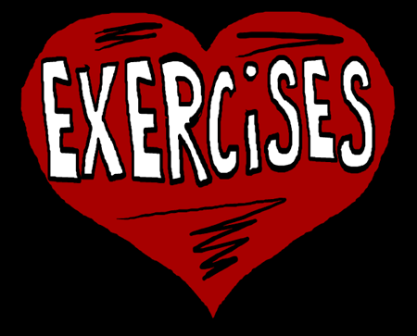
Body Type and You
Take 10 minutes and find 5 exercises that will impact your body type.

Slide 17
Sites used:
Center For Disease Control
SPARKS glossary of terms
Wikipeda
Presentation done by Roxanne Anderson

